Slide 1
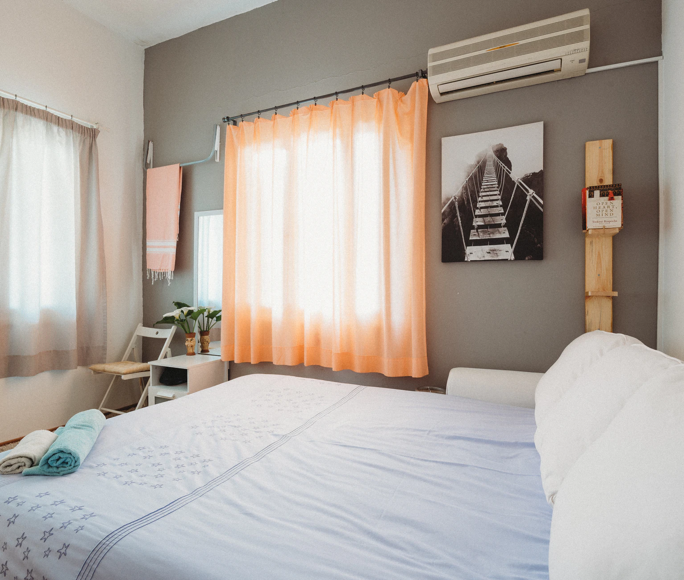

Airbnb Price recommender App
Get your Airbnb listing price at the snap of a finger

Slide 2



At Airbnb, we have noticed that homeowners are often unsure of the price to set for their property
Problem
Price is an important concern for customer booking travel online.
Hotels leave you disconnected from the city & culture.

Slide 3



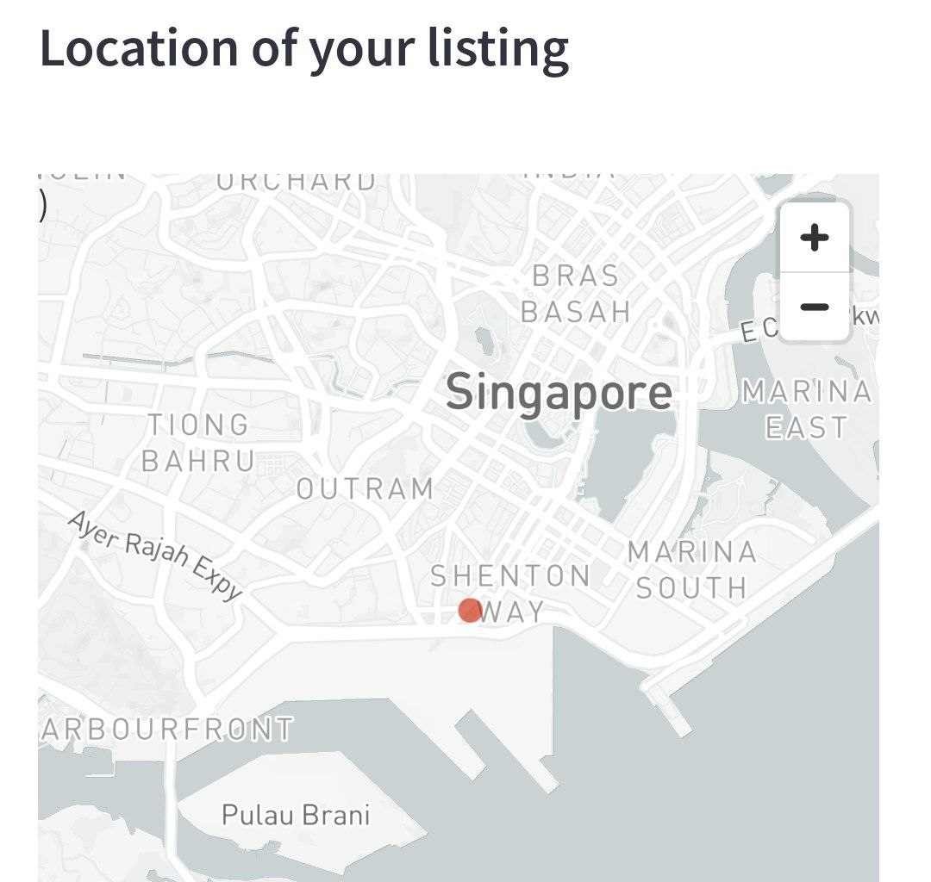



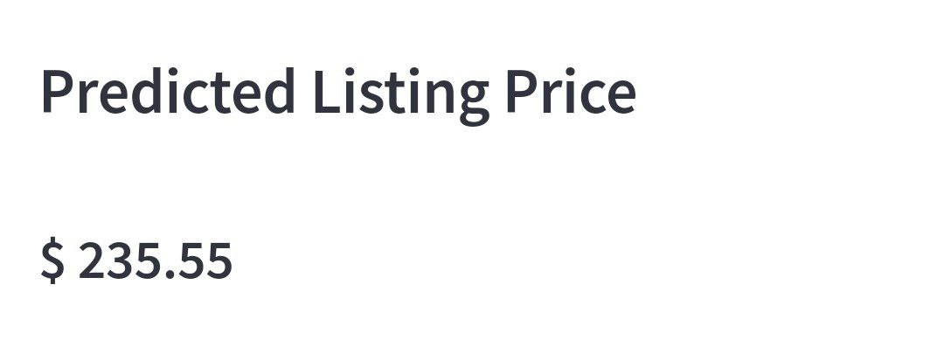
Solution
A web platform where users can …
Get recommend price for their listing
Gain insights on the features affecting the listings prices

Slide 4

Dataset
InsideAirbnb.com
4,000+ | User input data (Property type, beds and bathrooms …)
Airbnb listings in Singapore (as of 22 September 2022) | Implicit data generated from listings (Review scores, availability…)

Slide 5

Methodology
Data cleaning & EDA | Pre-processing Feature Engineering | Modelling & Evaluation | Web application & Deployment
Impute missing data | Select important amenities | Supervised ML predictive model (kNN, RF, LightGBM, XGBoost) | Predict Airbnb price based on user input data
Remove price outlier | Word count of listings title and descriptions | Metric evaluation of models | Convert address to Lat-long for Geomapping
Data visualisation (Feature plots and geo-mapping) | Listing proximity to MRT and City | Interpretability of features with SHAP | Generate feature insights using SHAP

Slide 6
Methodology
Data cleaning & EDA | Pre-processing Feature Engineering | Modelling & Evaluation | Web application & Deployment
Impute missing data | Select important amenities | Supervised ML predictive model (kNN, RF, LightGBM, XGBoost) | Predict Airbnb price based on user input data
Remove price outlier | Word count of listings title and descriptions | Metric evaluation of models | Convert address to Lat-long for Geomapping
Data visualisation (Feature plots and geo-mapping) | Listing proximity to MRT and City | Production model for web application | Generate feature insights using SHAP

Slide 7
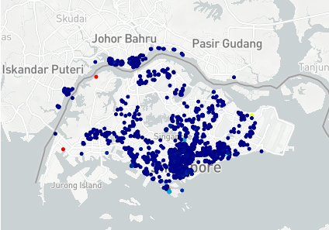
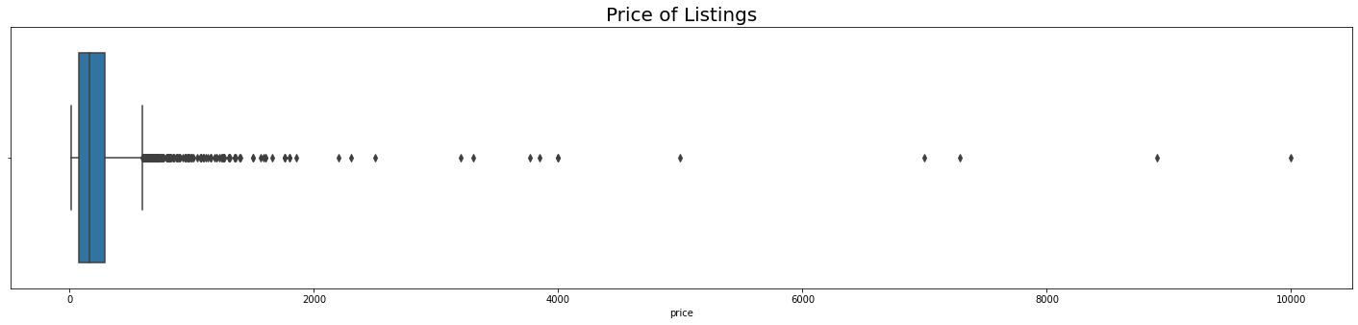
Data cleaning & EDA
Price outlier
Missing data | Impute missing data with mean or median values
Non-Singapore listings | Remove listings by filtering Neighborhoods and Latitude and Longitude
Price Outliers | Created box plot of Airbnb advertised price Price ranged from $13 to $9999 Outliers affect model performance Removed outliers using Interquartile range method

Slide 8
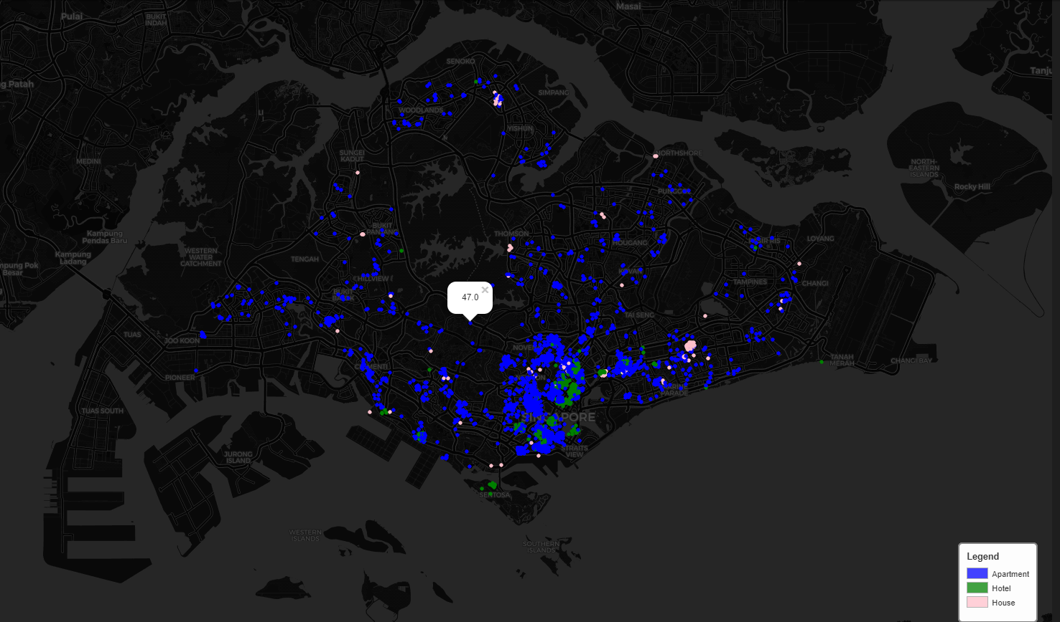
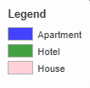
Airbnb locations and types
More than 80% of listings are located at Central region
“House” listings are sporadic around the island
Hotel listings are centered around the CBD and Southern Waterfront

Slide 9
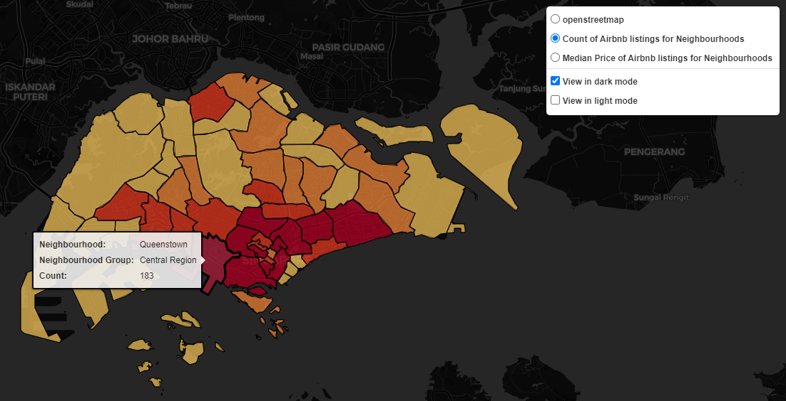
Count of Airbnb Listings
Central region has higher count of listings
and higher median prices compared to other neighborhoods and regions

Slide 10
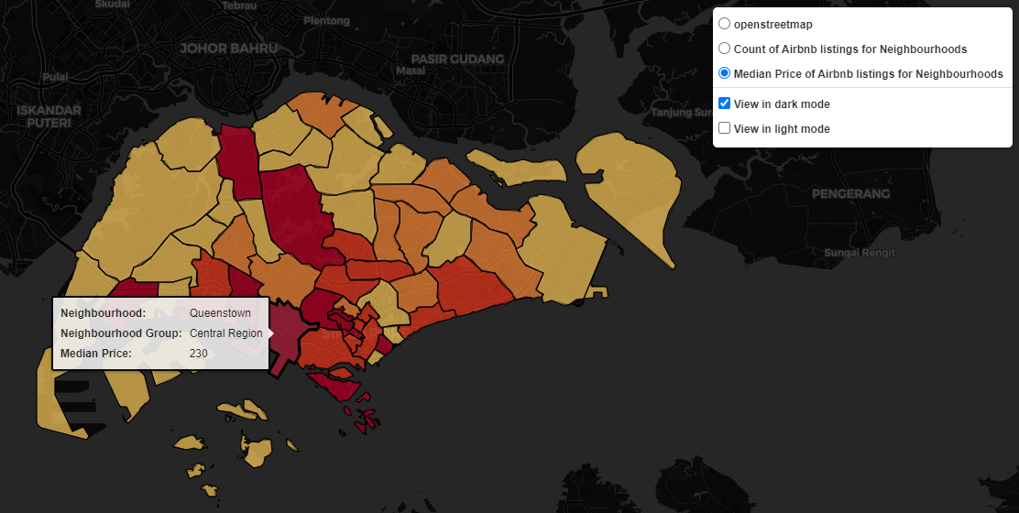
Median price of Airbnb Listings
Central region has higher count of listings
and higher median prices compared to other neighborhoods and regions

Slide 11
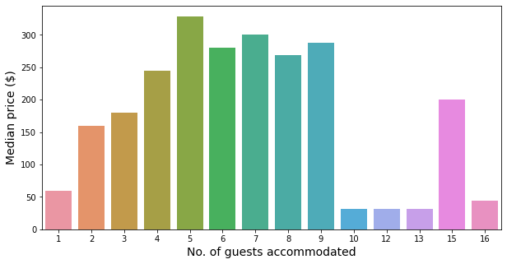
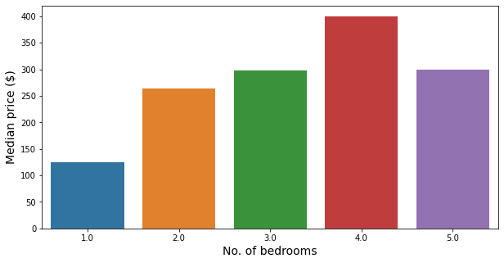
Accommodation Capacity
Median prices increased with no. of guests Sharp drop when accommodation capacity exceed 9 (Hostels) | Median prices increased with bedrooms 2 bedder is almost twice as expensive than single bedders

Slide 12
Methodology
Data cleaning & EDA | Pre-processing Feature Engineering | Modelling & Evaluation | Web application & Deployment
Impute missing data | Select important amenities | Supervised ML predictive model (kNN, RF, LightGBM, XGBoost) | Predict Airbnb price based on user input data
Remove price outlier | Word count of listings title and descriptions | Metric evaluation of models | Convert address to Lat-long for Geomapping
Data visualisation (Feature plots and geo-mapping) | Listing proximity to MRT and City | Production model for web application | Generate feature insights using SHAP

Slide 13
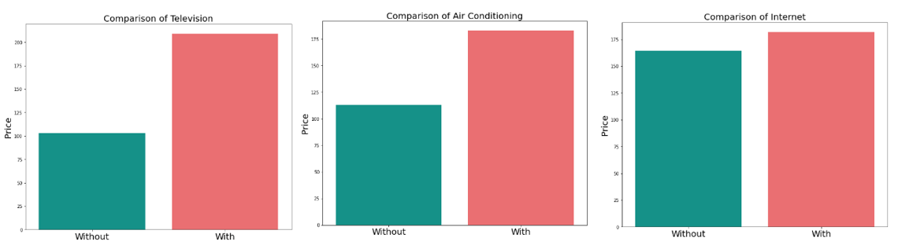
Pre-processing & Feature Engineering
Word count of Listing title and description | Distance to nearest MRT and City centre
Homeowners describe their listings such as amenities and location in their title and description Increases the click rate and likelihood of listings being booked | Location is important to Airbnb Calculated distance between Airbnb and MRT/city centre
Impact of amenities on Listings
Consumers expect amenities like Television, Air conditioning and Wifi to be available in the Airbnb Prices tend to be lower when homeowners do not provide these amenities

Slide 14
Methodology
Data cleaning & EDA | Pre-processing Feature Engineering | Modelling & Evaluation | Web application & Deployment
Impute missing data | Select important amenities | Supervised ML predictive model (kNN, RF, LightGBM, XGBoost) | Predict Airbnb price based on user input data
Remove price outlier | Word count of listings title and descriptions | Metric evaluation of models | Convert address to Lat-long for Geomapping
Data visualisation (Feature plots and geo-mapping) | Listing proximity to MRT and City | Production model for web application | Generate feature insights using SHAP

Slide 15
Model evaluation
Models | R² (Train) | R² (Test) | RMSE (Train) | RMSE (Test) | Generalisation
K-Nearest Neighbours | 1.0 | 0.678 | 0.0 | 76.0737 | 32.2%
Random Forest | 0.897 | 0.723 | 52.9443 | 74.5536 | 19.398%
Light GBM | 0.958 | 0.767 | 35.3059 | 69.126 | 19.937%
XGBoost | 0.762 | 0.696 | 80.1788 | 81.4321 | 8.661%
Selected XGBoost regression for the final model with full features and Production model
Lowest generalization score compared to the rest of the models
R Square value of 0.696 indicates the model can explain 69.6% of the variation
Higher RMSE score than others indicating a higher average deviation between prediction and actual price

Slide 16
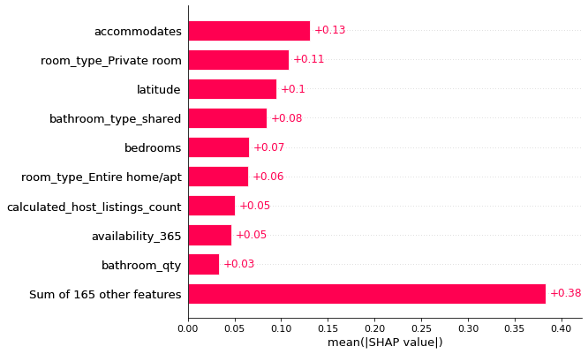
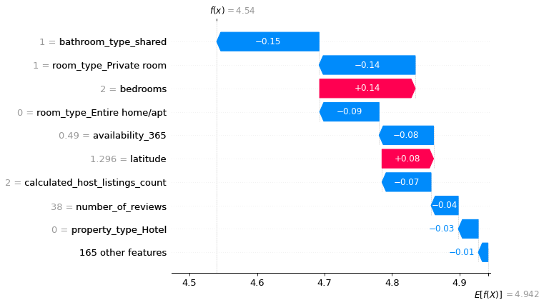
Model interpretation
Global interpretability | Local interpretability
Summarizes the impact of each feature on the overall model | Explains the prediction for a single observation, identifies feature that contributes to prediction
Prediction largely contributed by accommodates, private room, latitude, shared bathroom.. | Price has been logarithmically transformed Exponentiate predicted values to get actual price Predicted price = e^{4.54} = $93.40

Slide 17
Methodology
Data cleaning & EDA | Pre-processing Feature Engineering | Modelling & Evaluation | Web application & Deployment
Impute missing data | Select important amenities | Supervised ML predictive model (kNN, RF, LightGBM, XGBoost) | Predict Airbnb price based on user input data
Remove price outlier | Word count of listings title and descriptions | Metric evaluation of models | Convert address to Lat-long for Geomapping
Data visualisation (Feature plots and geo-mapping) | Listing proximity to MRT and City | Production model for web application | Generate feature insights using SHAP

Slide 18
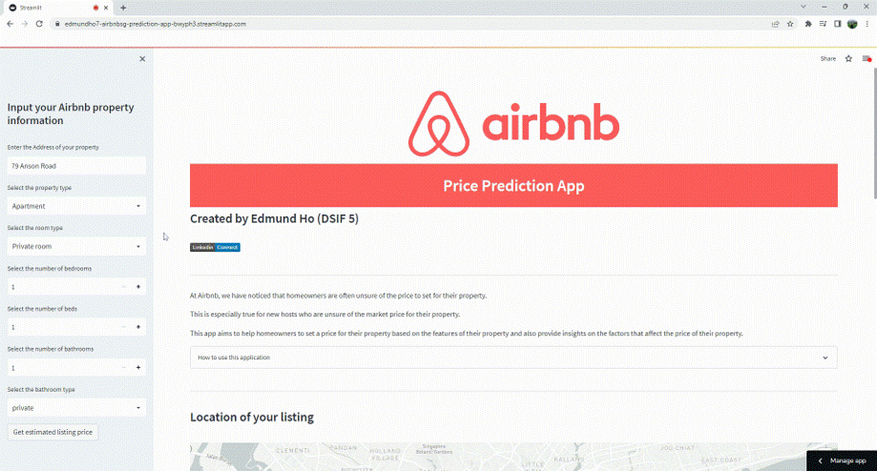

Web deployment
Come and try me!

Slide 19
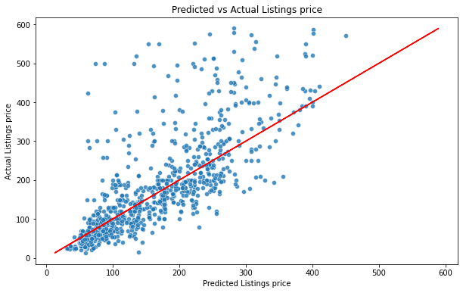
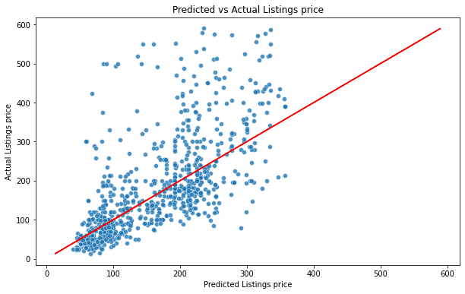
Full vs Production model
Full feature model
Production model
Full feature model perform fairly wells with majority of the predicted scatter points falling close to the diagonal line (representing perfect prediction) for listings below $250
Production model only can perform well for listings below $120
Both models underpredict listings above $250 and $120 respectively
Perform poorly for listings above $300 with prediction significantly lower than actual prices.

Slide 20
Conclusion & Recommendations
XGBoost was selected as the best performing model due to its much lower generalization score. The SHAP plot of the full feature model shows that accommodation capacity, room type, bathroom and bedrooms are the top features driving the price of an Airbnb listings.
For the production model, amenities was not being used as the feature for the models and this can be included in the future which might improve the model performance further.
Recommendations
Use a more accurate price data as the listing price used is set by the owner and not the actual price paid by the consumers
Improve the dataset by incorporating other features such as property size, unit level and proximity features to F&B and attractions
Remove hostels from the data as it has a high number of bedrooms/beds with low listing price, this affects the model performance
Incorporate the Airbnb amenities as features for the production model and web application

